Slide 1



Rules of Engagement
  I have the right to share my opinion and be listened to
  I have the right to pass
  I have the right to be respected and valued
  I have the right to keep what I discuss confidential *
  I have the right not to feel judged
  I have the right not to answer personal questions
*unless what I say is causing concern and needs to be shared
Stages of a romantic relationship/ Ages 14-16 years/ Slide 1

Slide 2
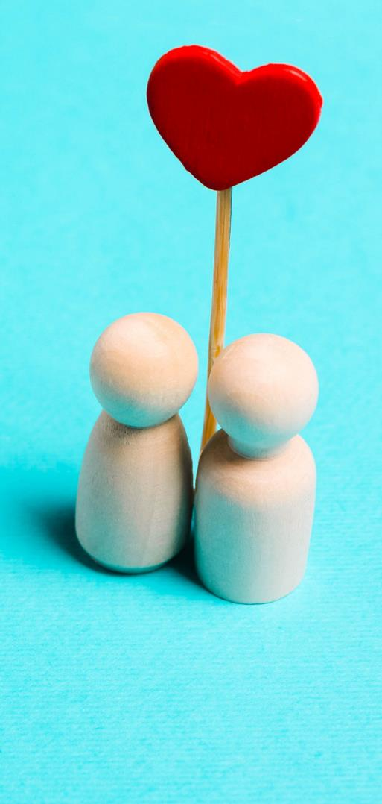
Stages of a romantic relationship
Scientists have identified there are some common stages in a romantic relationship:
  Crush or infatuation
  Loved up or the 'honeymoon period'
  Pair bonding (or not)
  Forever and ever
  Threat or challenge
  Deep and meaningful
Stages of a romantic relationship/ Ages 14-16 years/ Slide 2
Notes:
Take 10 Activity Choice 1: Stages of a romantic relationship
Start the activity by sharing PowerPoint Slide 2 and explain that scientists believe there are common stages of a romantic relationship- they are broadly linear with one phase moving to the next (except the threat or challenge phase) and some couples move through the stages more quickly than others. It can take several years to reach the final stage depending upon circumstances. Ask the students what they think the features of each stage might be and use the notes below to help you explain.
Some of these stages are portrayed in movies and books, but not always all. In pairs, ask the students to think of a movie or book plotline where a romantic relationship develops. Ask them to identify plot points that reflect the relationship stages on the slide. Take some feedback and use the prompt questions below to facilitate any discussion.
Stages of a romantic relationship
Crush or infatuation : Intense feelings of falling in love. The relationship can be real or imagined - wondering what it would be like to be with that person. The relationship is more likely to be non-physical at this stage. Scientists have identified this stage with a rise of oxytocin and dopamine in the brain causing the 'love rush' effect, and physical/ emotional feelings of being love-sick.
Loved up or the honeymoon period : Things are going well, and the relationship may include sex. The brain is still experiencing the effect of oxytocin and dopamine but as the months progress the levels of these hormones begin to drop and level out. This can lead to a drop in 'sexual chemistry', and sex may become less frequent and important in the relationship. Couples spend more time together and start creating a deeper connection as they get to know each other.
Pair bonding (or not) : The intensity of the romantic phase has faded and couples may start noticing more of their partner’s flaws and the way they really are. They have a more truthful view about their partner because it’s not clouded by hormones. Deeper affection may start to develop or they may see no future for the relationship and it could end.
Forever and ever : Partners seek to formalise their long-term commitment for example, through marriage; moving in together, choosing to have children etc. Comfort and security are important and deeper trust has developed between partners. As a result, a relationship loss or break up at this stage can be very hurtful.
Threat or challenge : This can happen at any stage of a relationship. Most couples will experience major life events during their time together; having children, illness, bereavement, maybe cheating. These are the times in the relationship where partners need to ‘work at it' and can result in a longer term commitment or a relationship ending if things don't work out.
Deep and meaningful : This is a shared understanding of longer-term outcomes that go beyond staying together for children, finances and sex. It’s a deep affection that is lasting.
Prompt questions
Are all these relationship stages portrayed in movies or books? Why / why not?
Do you think plotlines in fictional works portray a realistic image of romantic relationships?
What are fictional stories trying to 'sell us' about relationships? Is this fair? Are they like real life?
What are the risks of being influenced too much by movies and books when it comes to romantic relationships?

Slide 3
Do our relationship values change as we get older?
Write down three values or characteristics you think are important in a romantic relationship for each age-range.
Are there some that you would put in every column, or some that are more relevant to a particular age?
Teenagers
30 - 40 year olds
70-80 year olds
Stages of a romantic relationship/ Ages 14-16 years/ Slide 3
Notes:
Take 10 Activity Choice 2: Relationship values : young to old
Show the chart on PowerPoint Slide 3 and ask students to populate each column with three values or characteristics they feel are important to a romantic relationship at different stages of life. They may choose to have some values that appear in each column, but there may be some that are more or less important than others at different stages. To help them, invite the class to consider what priorities people may have at each age. For example starting a family may be more relevant to people aged 30-40. Ask the students to complete their own charts in pairs or small groups and then take some feedback. What values do the class feel are consistently important, and which are more or less so depending on the age and stage of the relationship?

Slide 4

When it's over it's over...
but how do you break up respectfully?
Write 3 'Dos'..
...and 3 'Don'ts'
Stages of a romantic relationship/ Ages 14-16 years/ Slide 4
Notes:
Take 10 Activity Choice 3: Break-ups: do's and don’ts
Use PowerPoint Slide 4 as a stimulus and say this task is about respectful ways to end a romantic relationship when it's over for one partner or both. With the students in small groups ask them to list 3 'do's' and 3 'dont's' about how to break up as respectfully as possible. Take some feedback then go through the advice on PowerPoint Slides 5-7. Do the students feel this advice is realistic or not?

Slide 5

Breaking up : how to do it
Acknowledge that it will be painful for one or both and be prepared for the fall-out from this. Knowing what might come can help you prepare for the aftermath. Practise what you're going to say.
Texting is a rude and disrespectful way to break-up. It shows little consideration for the other person- even if they have hurt you. Be the bigger person and tell them face to face. If you're worried their reaction may be violent or abusive, break-up in a public space, or in this circumstance texting might be the safest thing to do.
One more chance conversations. If it has come to the point of ending the relationship, is giving it 'one more chance ' likely to make a difference?
Stages of a romantic relationship/ Ages 14-16 years/ Slide 5

Slide 6
Breaking up : how to do it
Pick your moment. At a special occasion or just before an exam would be a thoughtless action.
Be honest with the reasons why and use 'I statements' such as 'I'm not happy with the relationship' rather than putting all the blame onto the other person. It's rarely all on one person.
Don't do a blow by blow account of everything that's wrong- it's just a waste of energy and prolongs the discussion.
It may be appropriate to show some empathy for the other person- even if you don't want to see them ever again- you don't know for sure how they're feeling inside. Try to put yourself in their shoes if that's fitting.
Stages of a romantic relationship/ Ages 14-16 years/ Slide 6

Slide 7
Breaking up : how to do it
Avoid shaming them. It might make you feel better, but will it do anything to ease the situation?
Allow yourself to be upset. This person has been significant in your life. You may feel sad and grieve them for a while. That's natural.
Acknowledge they may see you as 'the bad person' and be prepared to own that.
Remember that you don't have to be enemies. Some people remain friends with their exes after a break-up. It depends on the circumstances and the people involved.
Stages of a romantic relationship/ Ages 14-16 years/ Slide 7

Slide 8

Give some examples of romantic couples in soaps.
What happened to them- did their relationships last?
Stages of a romantic relationship/ Ages 14-16 years/ Slide 8
Notes:
Take 20 Activity Choice 1: Soap opera couples
Characters in soap operas rarely have a relationship that lasts. This activity seeks to change that idea. To open the activity briefly ask the students to give a few examples of romantic relationships in soap operas and what happened to the couples (PowerPoint Slide 8). Ask why the couples never seem to last (because it would probably make for a very dull plotline). Go through the stages of a romantic relationship (see Take 10 Activity 1 and PowerPoint Slide 2). Skip this if you have already done the activity. Divide the class into groups and explain they are going to create their own soap opera couple and take them through the stages of a romantic relationship (PowerPoint Slide 9).
The next few slides will guide them through the process, and they can put the 'threat' or 'relationship challenge' anywhere in their story, but the couple must survive and work through their problems. Move through PowerPoint Slides 10-15 pausing each time to allow the students to jot down the next part of the story- they only need to make the briefest of notes each time, and the activity is also more fun if they only have a limited time to create the next plot point before moving on. At the end of the activity ask some of the students to share their storylines and use these to highlight the changes that happen in romantic relationships over time.

Slide 9
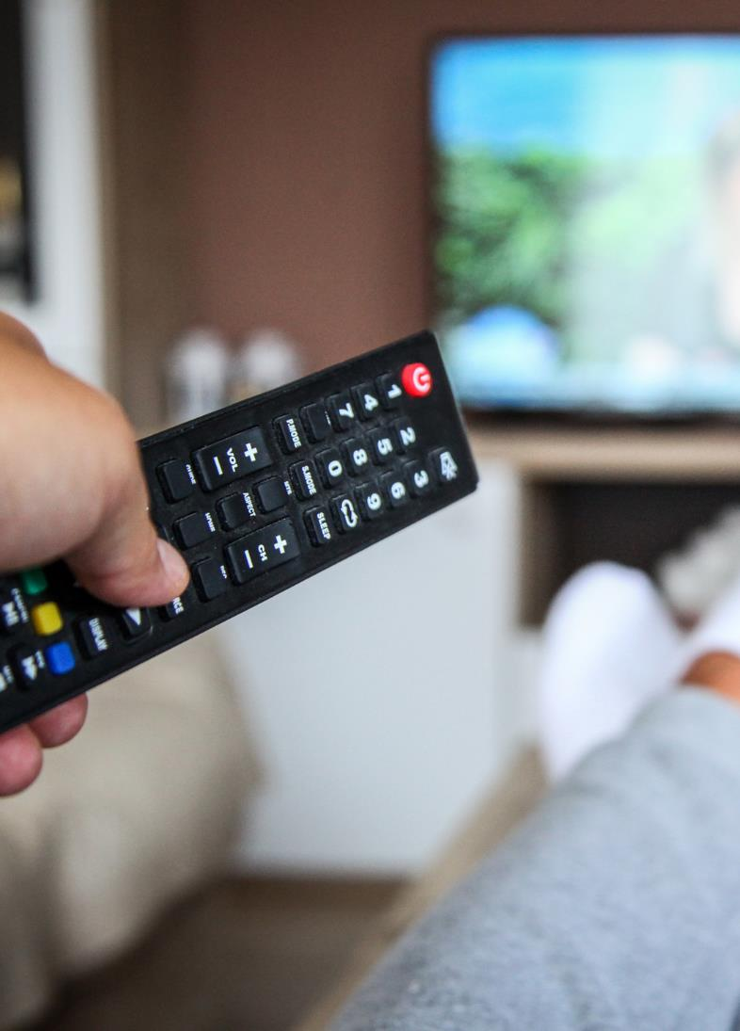
Create your own soap opera couple- they can be of any gender, sexual orientation, culture or race. It's up to you. They are 16 at the start of the story.
You'll then take them through the different stages of their relationship.
You can put the 'threat' or 'challenge' to their relationship anywhere you like in the story- but they must work through the problem and stay together.
The next few slides will guide you through your story creation. You'll only have a minute or so in between slides so think quickly and write your story in note form.
Stages of a romantic relationship/ Ages 14-16 years/ Slide 9

Slide 10

The crush or infatuation
Who fancied who?
Where / how did they meet?
How did they eventually get together?
Stages of a romantic relationship/ Ages 14-16 years/ Slide 10

Slide 11
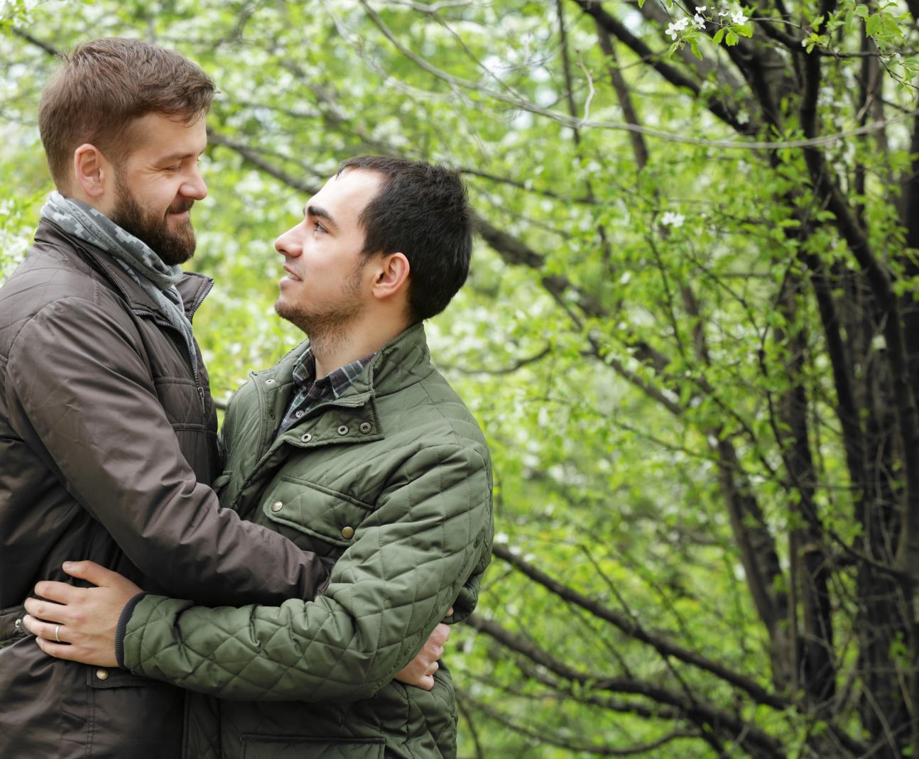
Loved up
What do they most like about each other?
How much time do they spend together?
Stages of a romantic relationship/ Ages 14-16 years/ Slide 11

Slide 12

Pair bonding
What's got 'deeper' about their relationship?
Stages of a romantic relationship/ Ages 14-16 years/ Slide 12

Slide 13
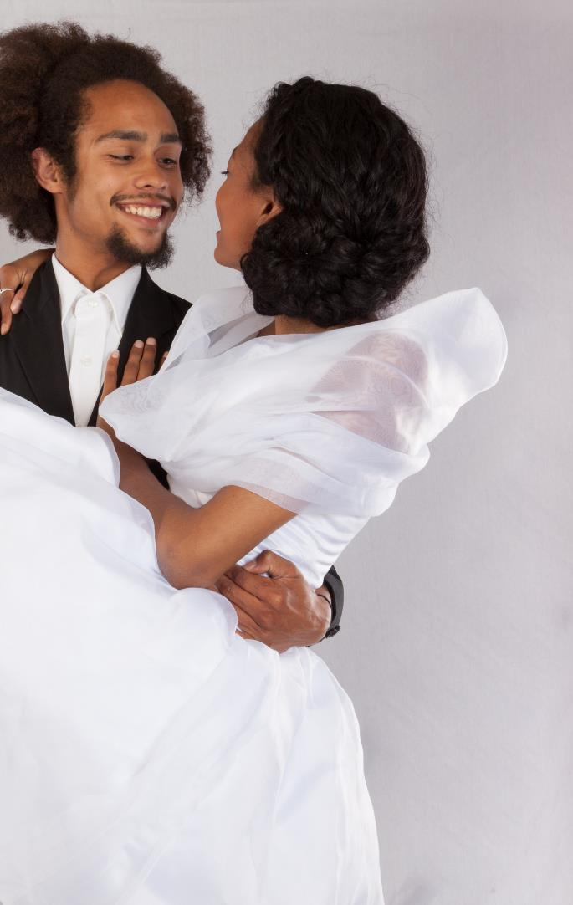
Forever and ever
What long term commitments have they made to each other?
Stages of a romantic relationship/ Ages 14-16 years/ Slide 13

Slide 14

Deep and meaningful
What are the positives of their relationship now they have been together for many years?
Stages of a romantic relationship/ Ages 14-16 years/ Slide 14

Slide 15
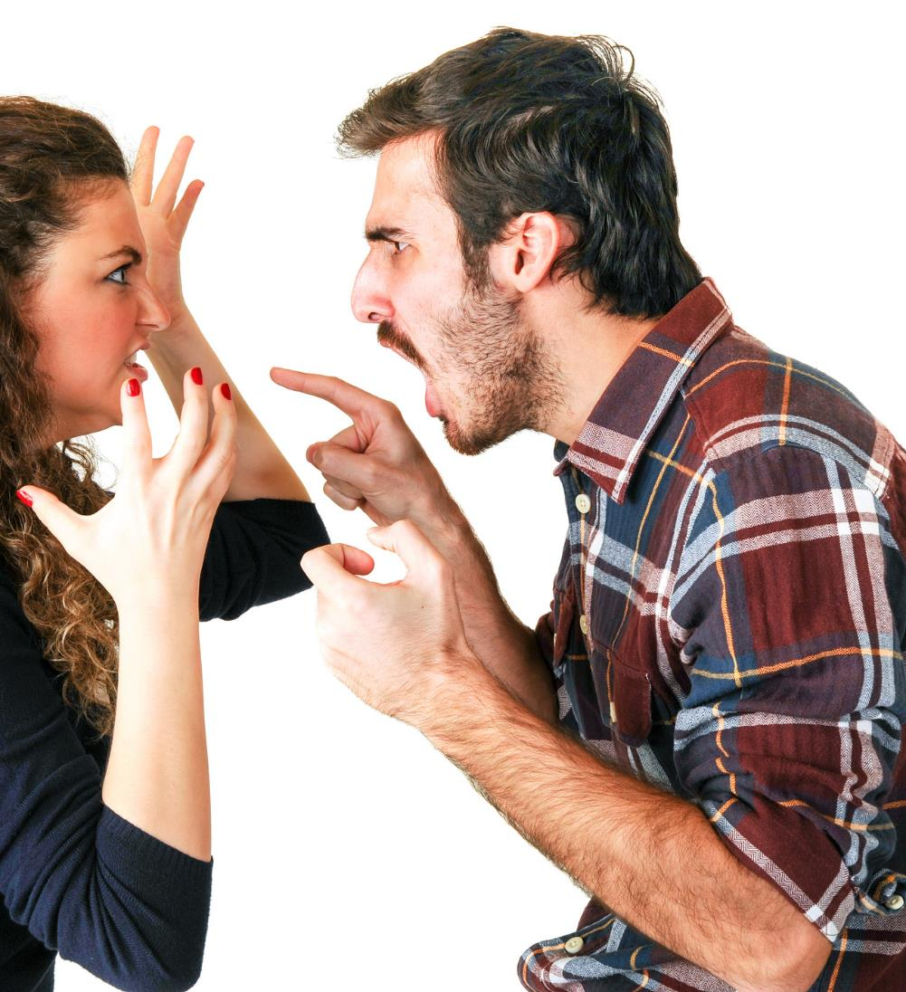
Threat or challenge
If you haven't included a threat or challenge in their relationship- go back and put one in.
What is the threat and how did they overcome it?
Stages of a romantic relationship/ Ages 14-16 years/ Slide 15

Slide 16
Long-term, stable and committed relationships
Benefits to the partners when this type of relationship is going well
Disadvantages for the partners when this type of relationship isn't going well
Benefits to the family (children and other relatives) when this type of relationship is going well
Disadvantages to the family (children and other relatives) when this type of relationship isn't going well
Stages of a romantic relationship/ Ages 14-16 years/ Slide 16
Notes:
Take 20 Activity choice 2: Benefits of long-term, stable relationships
This activity seeks to explore the benefits of healthy, long-term, committed relationships. Share the quadrant chart on PowerPoint Slide 16 and with the students working in groups, ask them to complete the different quadrants. They should try to put at least 5 points under each heading. Afterwards take some feedback from the different groups and discuss how long-term and stable relationships benefit everyone in a family and not only the partnership at the centre. Use the following notes to facilitate any discussion:
When a long-term relationship is going well the benefits can include:
Close source of support available
Intimacy
Shared goals
Increased security (any children would also feel this)
Different interests bring additionality to the relationship
People in this type of relationship take less risks as they are accountable to their partner/ family
Better for mental health
Partners can help each other maintain healthy lifestyles
There's more than one person to raise any children
It can mean a second income for greater financial stability
An extended family can provide additional friendship and support

Slide 17

Top Tens
Write down 2 ideas for each piece of flipchart that comes to your group.
You'll have about 2 minutes per flipchart.
You can't repeat what another group has written.
Stages of a romantic relationship/ Ages 14-16 years/ Slide 17
Notes:
Take 30 Activity choice: Top Tens
Prepare five pieces of flipchart paper each with one of the following headings:
10 ways to know if someone likes you
10 healthy ways to get over an ex or to get over someone who doesn't like you back
10 ways to ask someone out
10 ways you know your relationship is working out
10 ways you might know your relationship is struggling
Divide the class into 5 groups and give each one, one of the headed flipcharts. Ask each group to write two suggestions on their flipchart and then stop (PowerPoint Slide 17). Rotate the flipcharts and repeat until every group has contributed 2 items to each heading.
Ask groups to share the completed flipcharts. Ask for any additional items after each list has been read. Discuss how it felt to do the activity. What are the 'takeaways' from this activity about how to successfully manage change in a romantic relationship? Were there any common themes that came through?
To conclude the activity explain that relationships are complex and may go through rough patches or experience problems from time to time. On the whiteboard or another piece of flipchart, write: “Top 10 people or places that young adults can get support or info about sex and relationships”. Compile this list as a class and ensure it includes local sexual health services and people/ services in school that students can go to for help and advice.

Slide 18
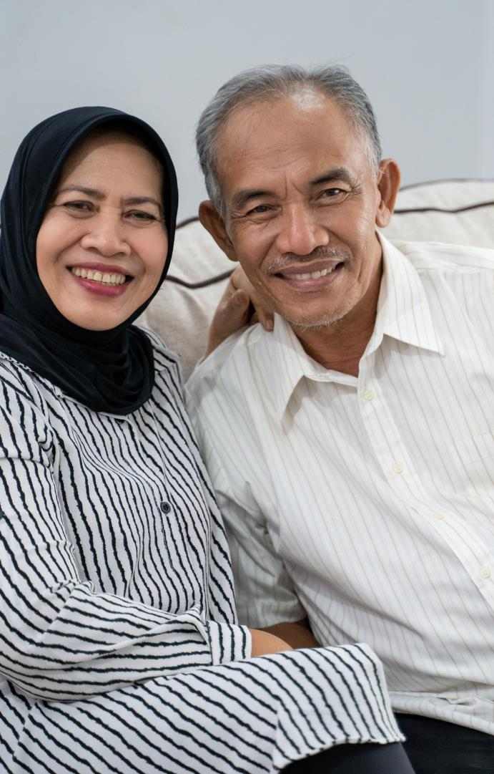
Challenge Task
  We can learn a lot about how to make our personal relationships successful from the older generation who have lived experience.
  Imagine you are going to interview an older couple who have had a successful and loving relationship for many years.
  Write a list of interview questions that you think would be helpful to find out about them, their relationship, the benefits and how it has thrived for so many years.
Stages of a romantic relationship/ Ages 14-16 years/ Slide 18

Slide 19

It's a wrap!
  Romantic relationships are a part of many people’s lives. It is up to you if you want this sort of relationship or not, and you should never feel pressured into one.
  A romantic relationship requires commitment and effort to stay together if you want it to last, especially longer-term when the hormonal 'rush' of being together can start to fade after a few months or years.
  Most relationships experience change, and if things aren't going well it's important to seek help and support for both of you, or individually depending on the issues. Some people think that seeking help for a relationship is a sign of weakness- it isn't.
  Counselling services such as Relate have saved many relationships, or helped couples to move on amicably if they decide to separate.
Stages of a romantic relationship/ Ages 14-16 years/ Slide 19
Notes:
Safeguarding
You will know your group and setting well, please refer to your safeguarding procedures as it’s possible that some students may be affected by the content. This pack deals with changes in relationships which some students may have experienced either themselves or in situations at home. Disclosures can happen at any time, so if a student does make worrying remarks or displays troubling behaviour, then you should follow the school's safeguarding procedures. Use of the ground rules on Slide 1 is vital to create a safe space for this learning so that students can discuss the content respectfully, and choose to pass if any content is upsetting for them. Please adapt activities to suit the needs of your class if you need to.

Slide 20

Help and advice
https://teenhealthsource.com/?s=relationships
https://www.gettingiton.org.uk/useful-contacts
https://www.brook.org.uk/topics/relationships/
Stages of a romantic relationship/ Ages 14-16 years/ Slide 20

Slide 21

Homework task
What have you learned about how romantic relationships change and how to manage these changes?
Write down 5 points that have made an impact on you.
Stages of a romantic relationship/ Ages 14-16 years/ Slide 21

