Slide 1



Rules of Engagement
    I have the right to share my opinion and be listened to
    I have the right to pass
    I have the right to be respected and valued
    I have the right to keep what I discuss confidential *
    I have the right not to feel judged
    I have the right not to answer personal questions
*Unless what I'm saying causes concern and needs to be shared
Physical changes at puberty / Ages 11-12 years/Slide 1
Notes:
Safeguarding
The content of these activities is sensitive in nature as it deals with the biological changes in humans during adolescence. Some pupils may find this worrying and have lots of questions, so this is an opportunity to offer reassurance. Some pupils may not have received this education at primary school, or it may have only been covered very briefly. Use of the Ground Rules on Slide 1 is essential to create a safe and comfortable environment to learn this content. Use of Take 10 Activity 1 is also helpful as it provides a space for the students to ask questions, which can be addressed throughout. Should students make disclosures that cause concern, you should discuss this with your Safeguarding Officer. If you have a School Health Nurse, these activities could be co-delivered with them. (See also notes about trans students below).
The terminology used in this session refers to the biological changes experienced by boys and girls. If you have gender-questioning children in your class we recommend speaking to them and ideally their parents in advance to decide how these young people engage with the session. It's useful for all students to understand what happens to their peers, however, if you are a mixed school and would like to separate boys and girls to support more open discussion for some areas this may be something you wish to consider. Please do whatever is most appropriate for the needs of the students in your setting.
There is reference to an ovum being fertilised in take 10 activity 3, slide 25. If students have not covered conception either in science or at primary school, you may wish to modify this slide.

Slide 2

Take 10 activity 1
Do you have any questions about puberty?
Physical changes at puberty / Ages 11-12 years/Slide 2
Notes:
Take 10 Activity Choice 1: Questions about puberty
This activity helps students ask any questions they have about puberty, which can then be followed up throughout the rest of the lesson. Some teachers prefer to make this an anonymous activity which can encourage more openness from the students, but also gives an opportunity for 'joke questions', while others ask students to initial or write their name on the questions. The benefit of the latter approach is that it's easier to follow up a safeguarding concern if you know which pupil has raised it. This activity could be completed prior to the lesson so it gives you an opportunity to see what questions have been asked. This also gives you more time to prepare appropriate answers to the questions. You could also repeat the activity at the end of a session (or a week later) to see if there are any new or unanswered questions.
Hand out slips of paper to the students, give them time to write any questions they have about puberty. Show slide 3 which has some prompts. Collect them in a box or container. You can address the questions being asked either in a Q & A session, or integrated into other activities.

Slide 3

Take 10 activity 1
When
What
Why
Puberty
questions
How
many
How
do I...
Does it...
Physical changes at puberty / Ages 11-12 years/Slide 3

Slide 4
Take 10 activity 2
Female anatomy - can you label the diagrams correctly?
fallopian tubes
cervix
uterus
menstrual flow
period products
vulva
ovaries
vagina
Physical changes at puberty / Ages 11-12 years/Slide 4
Notes:
Take 10 Activity 2
This activity is designed to familiarise students with female anatomy. Show slide 4 and ask students to make a note of the term. Move through slides 5 to 11 giving students a few moments to try and match the term to the slide. Students can work in pairs and discuss or individually.
Slide 12 provides the terminology for the parts of the female genitalia. You can decide whether you wish to use this slide or not.

Slide 5

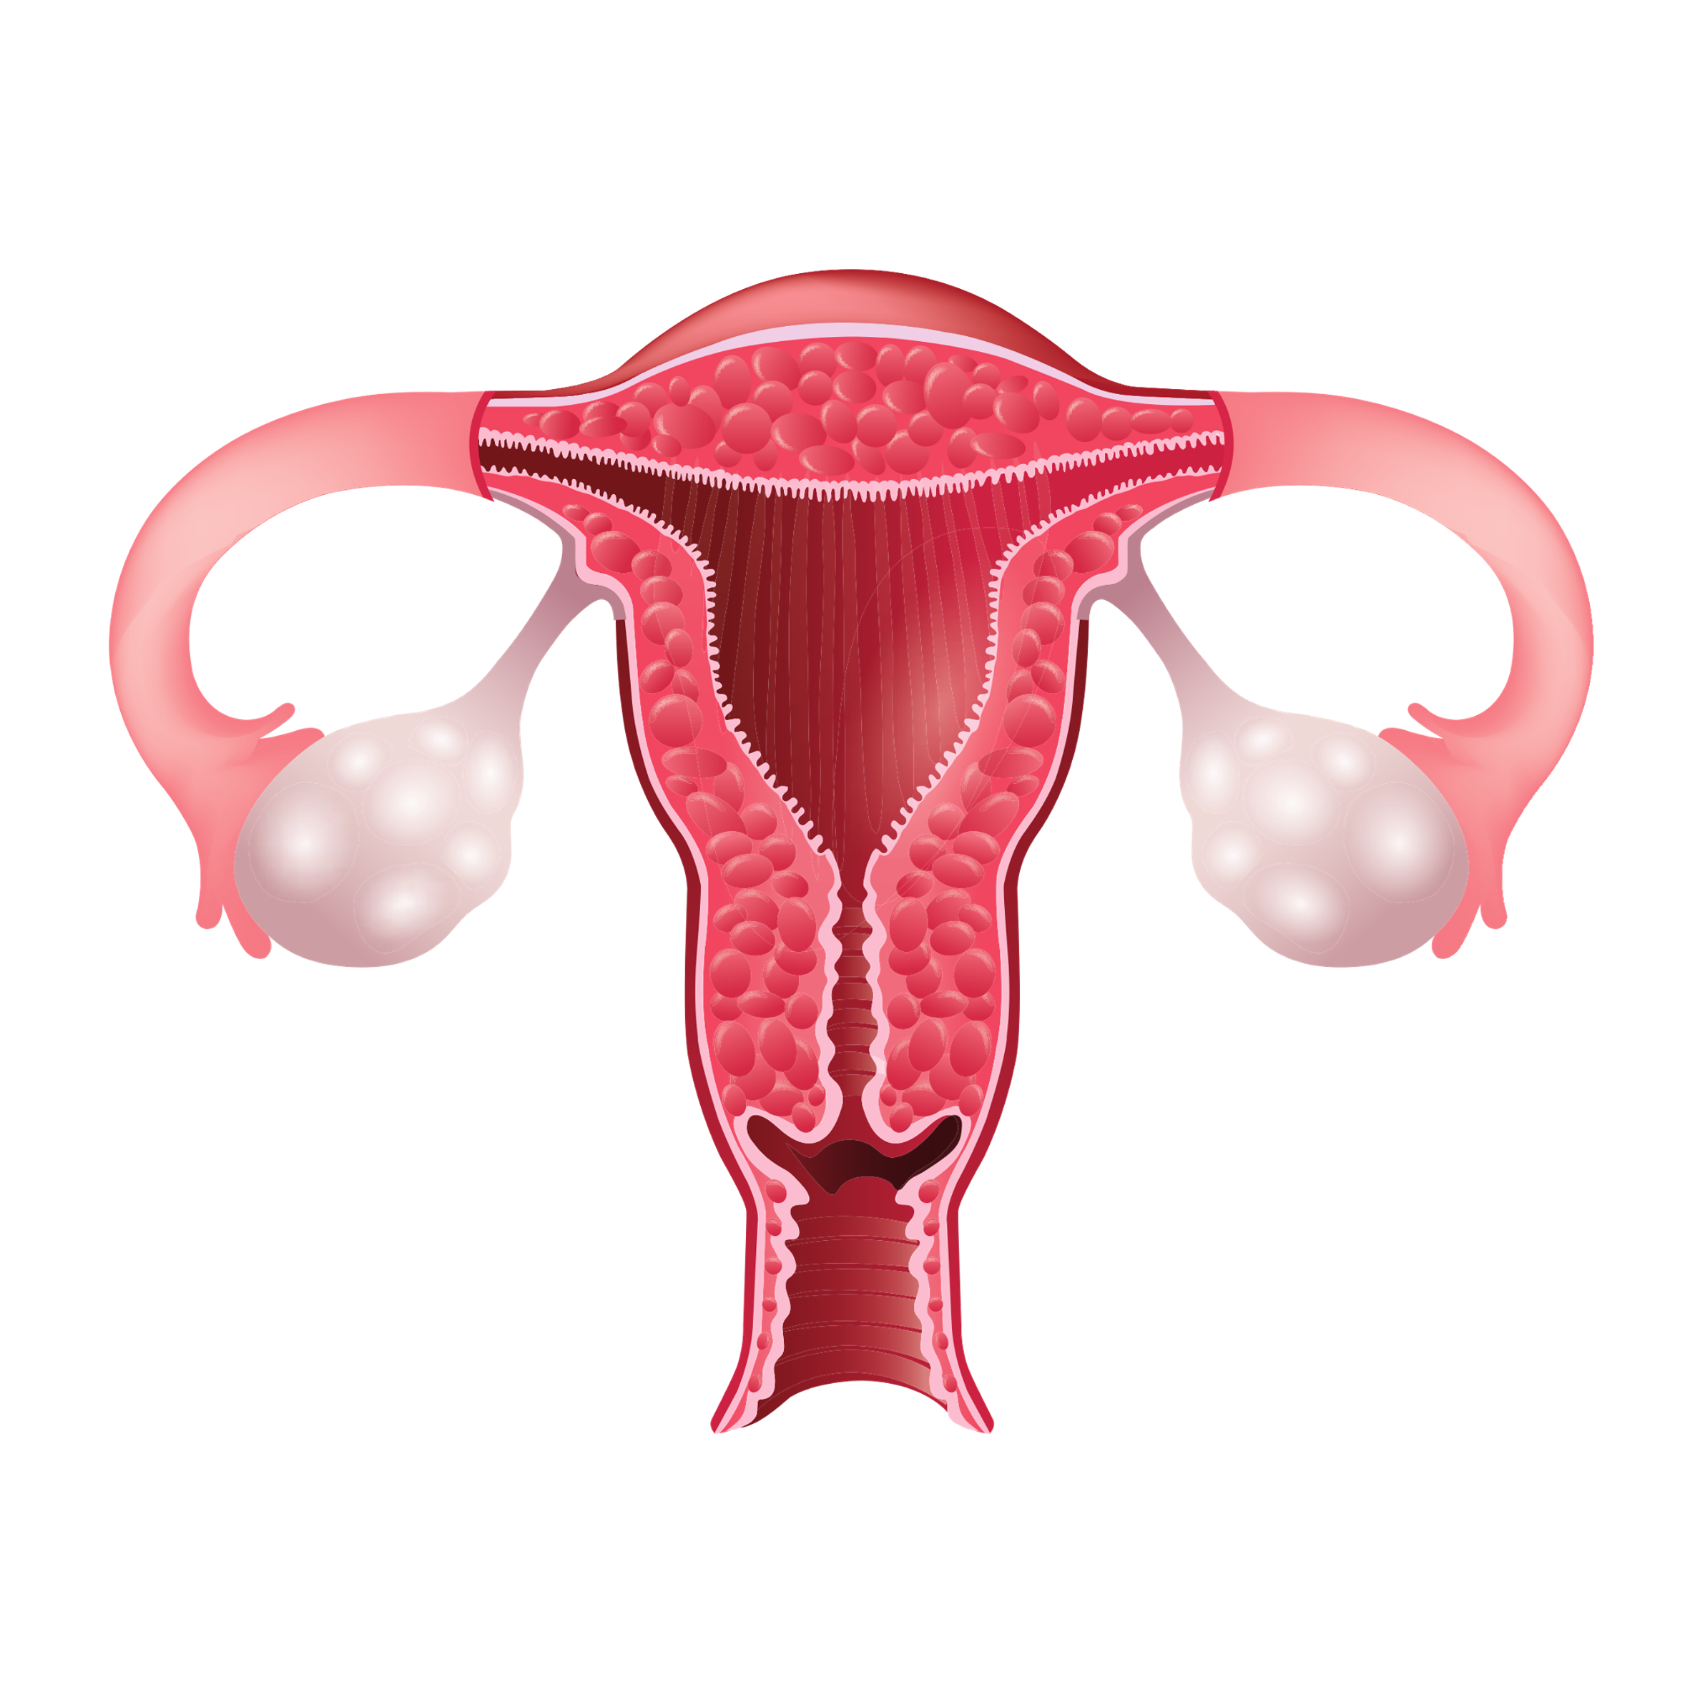
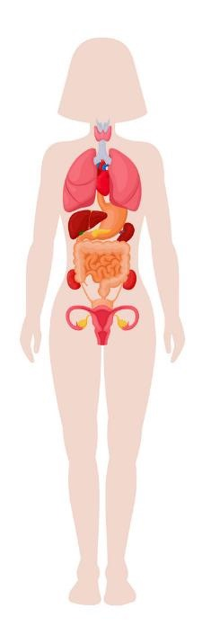




Take 10 activity 2
Physical changes at puberty / Ages 11-12 years/Slide 5
Notes:
Ovaries

Slide 6
Take 10 activity 2
Physical changes at puberty / Ages 11-12 years/Slide 6
Notes:
This is the uterus or womb

Slide 7
Take 10 activity 2
Physical changes at puberty / Ages 11-12 years/Slide 7
Notes:
Fallopian tubes

Slide 8
Take 10 activity 2
Physical changes at puberty / Ages 11-12 years/Slide 8
Notes:
Vagina

Slide 9

Take 10 activity 2
Physical changes at puberty / Ages 11-12 years/Slide 9
Notes:
Vulva

Slide 10
Take 10 activity 2
Physical changes at puberty / Ages 11-12 years/Slide 10
Notes:
Cervix

Slide 11


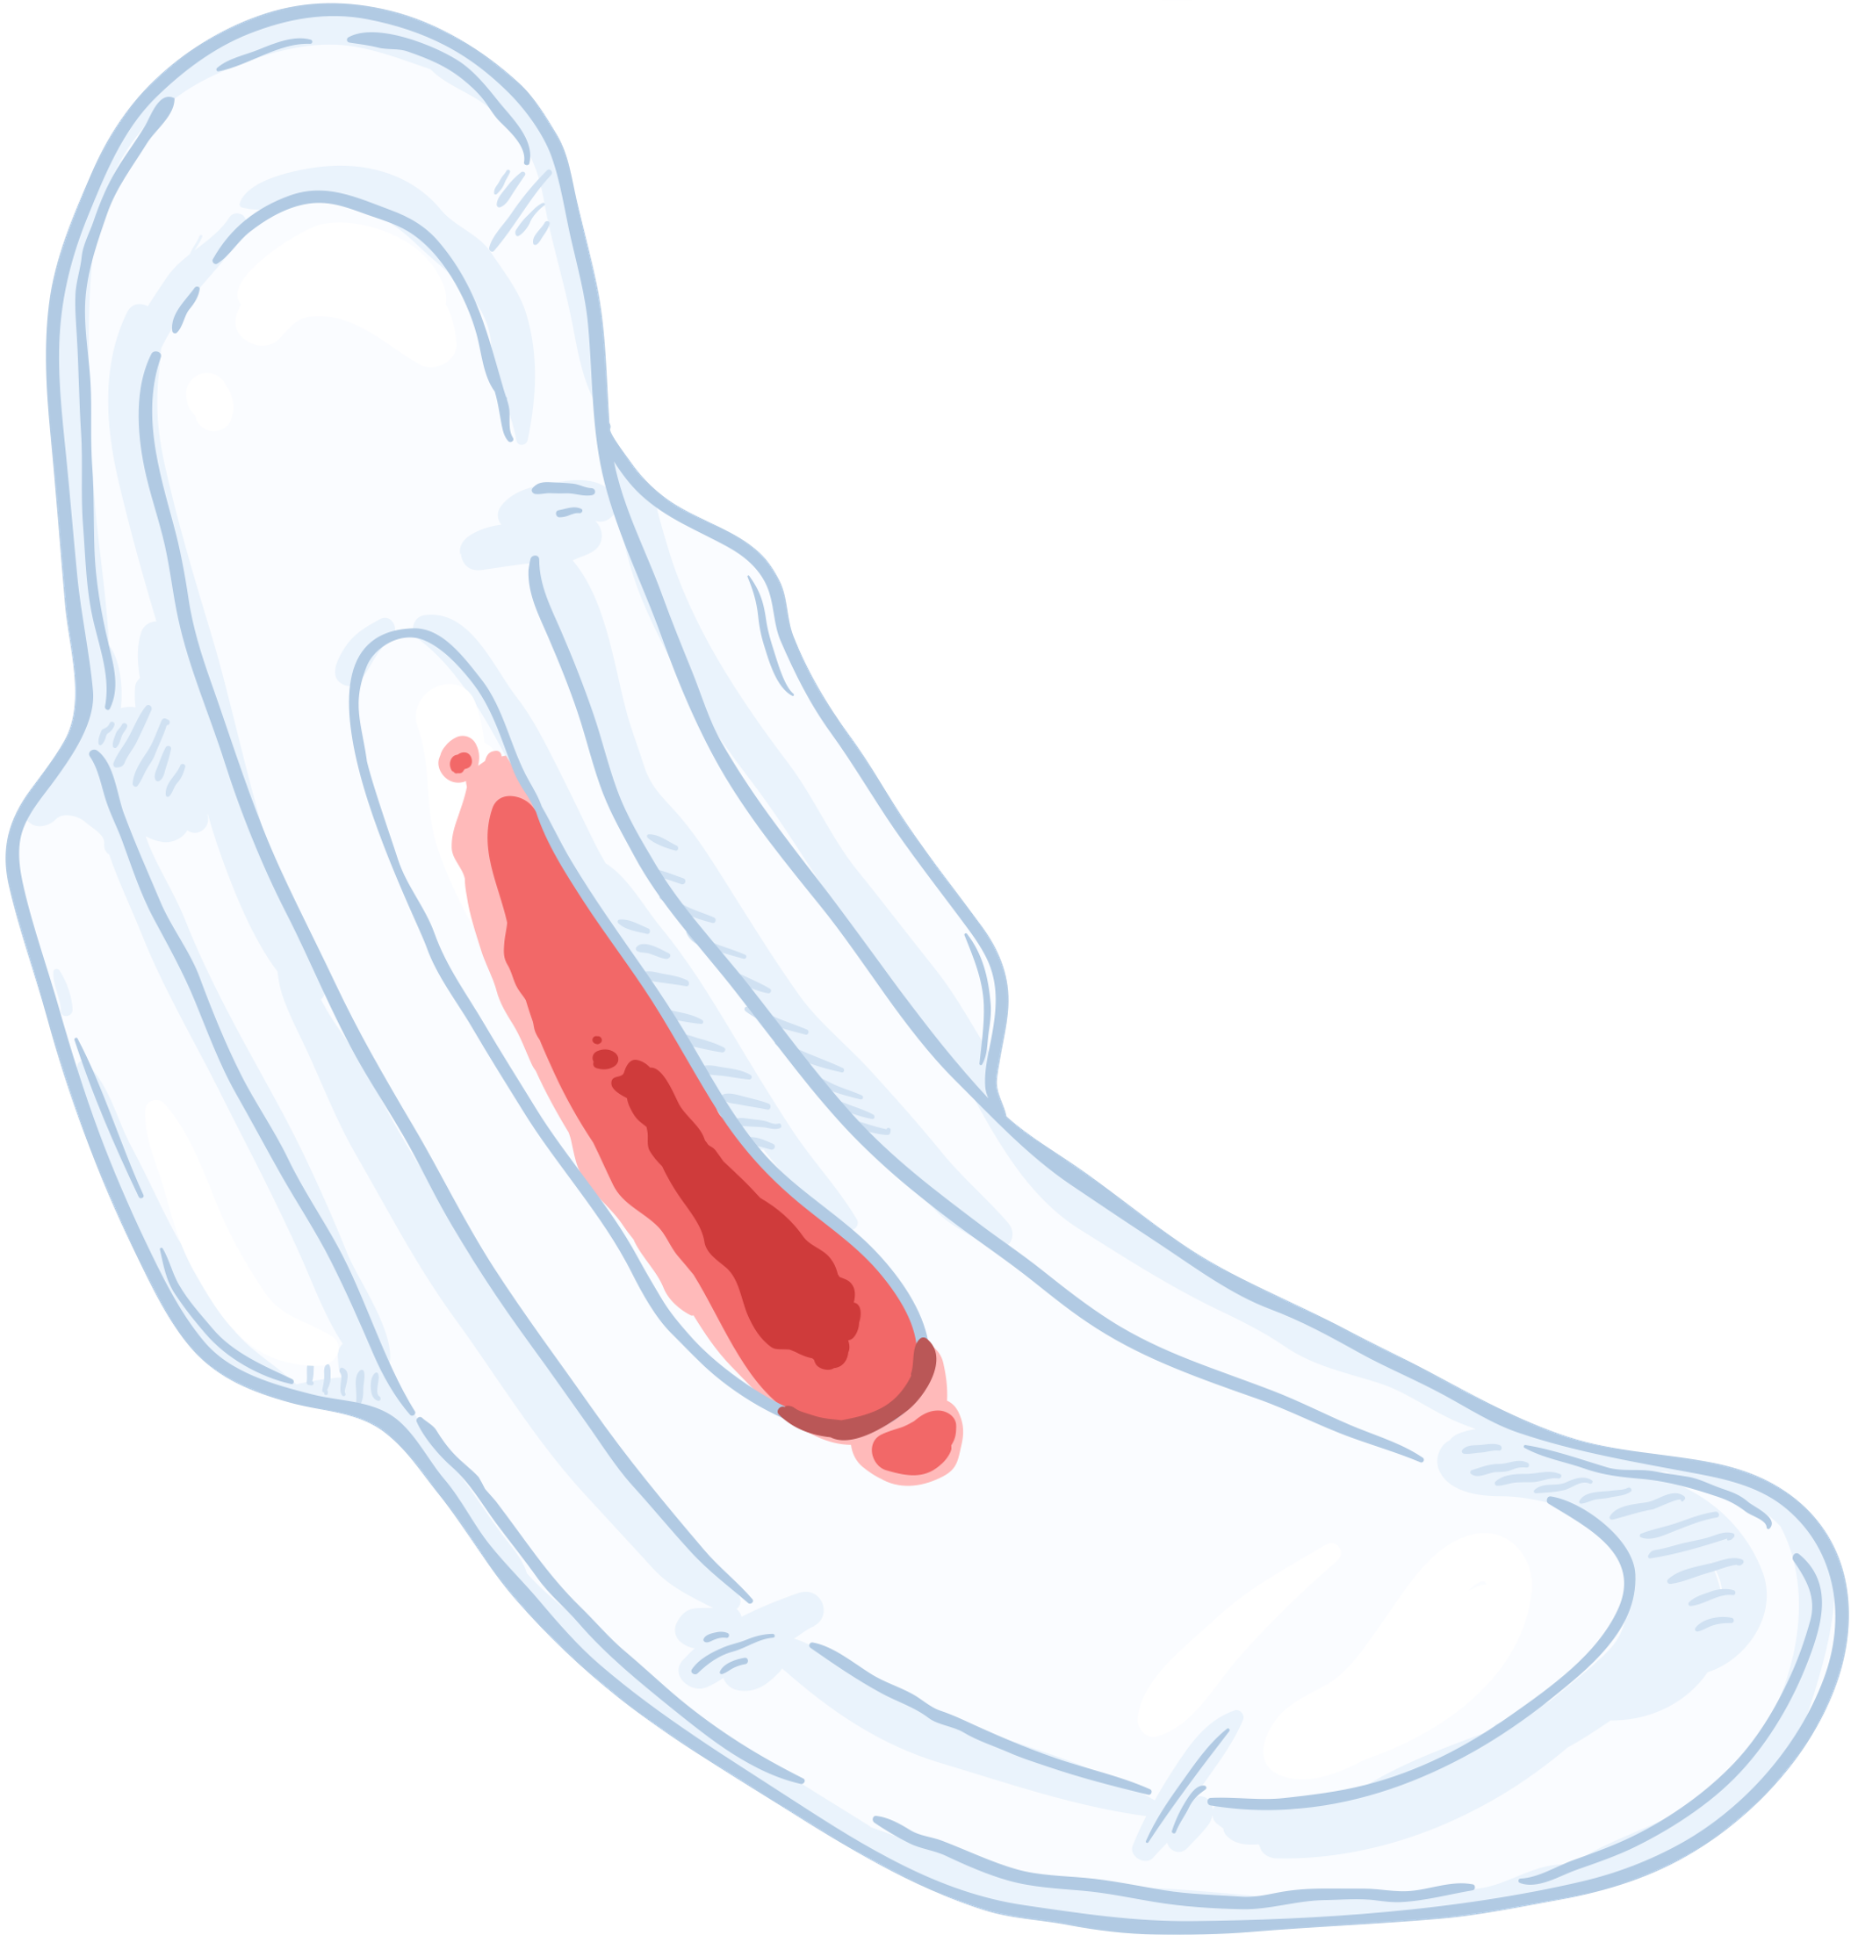
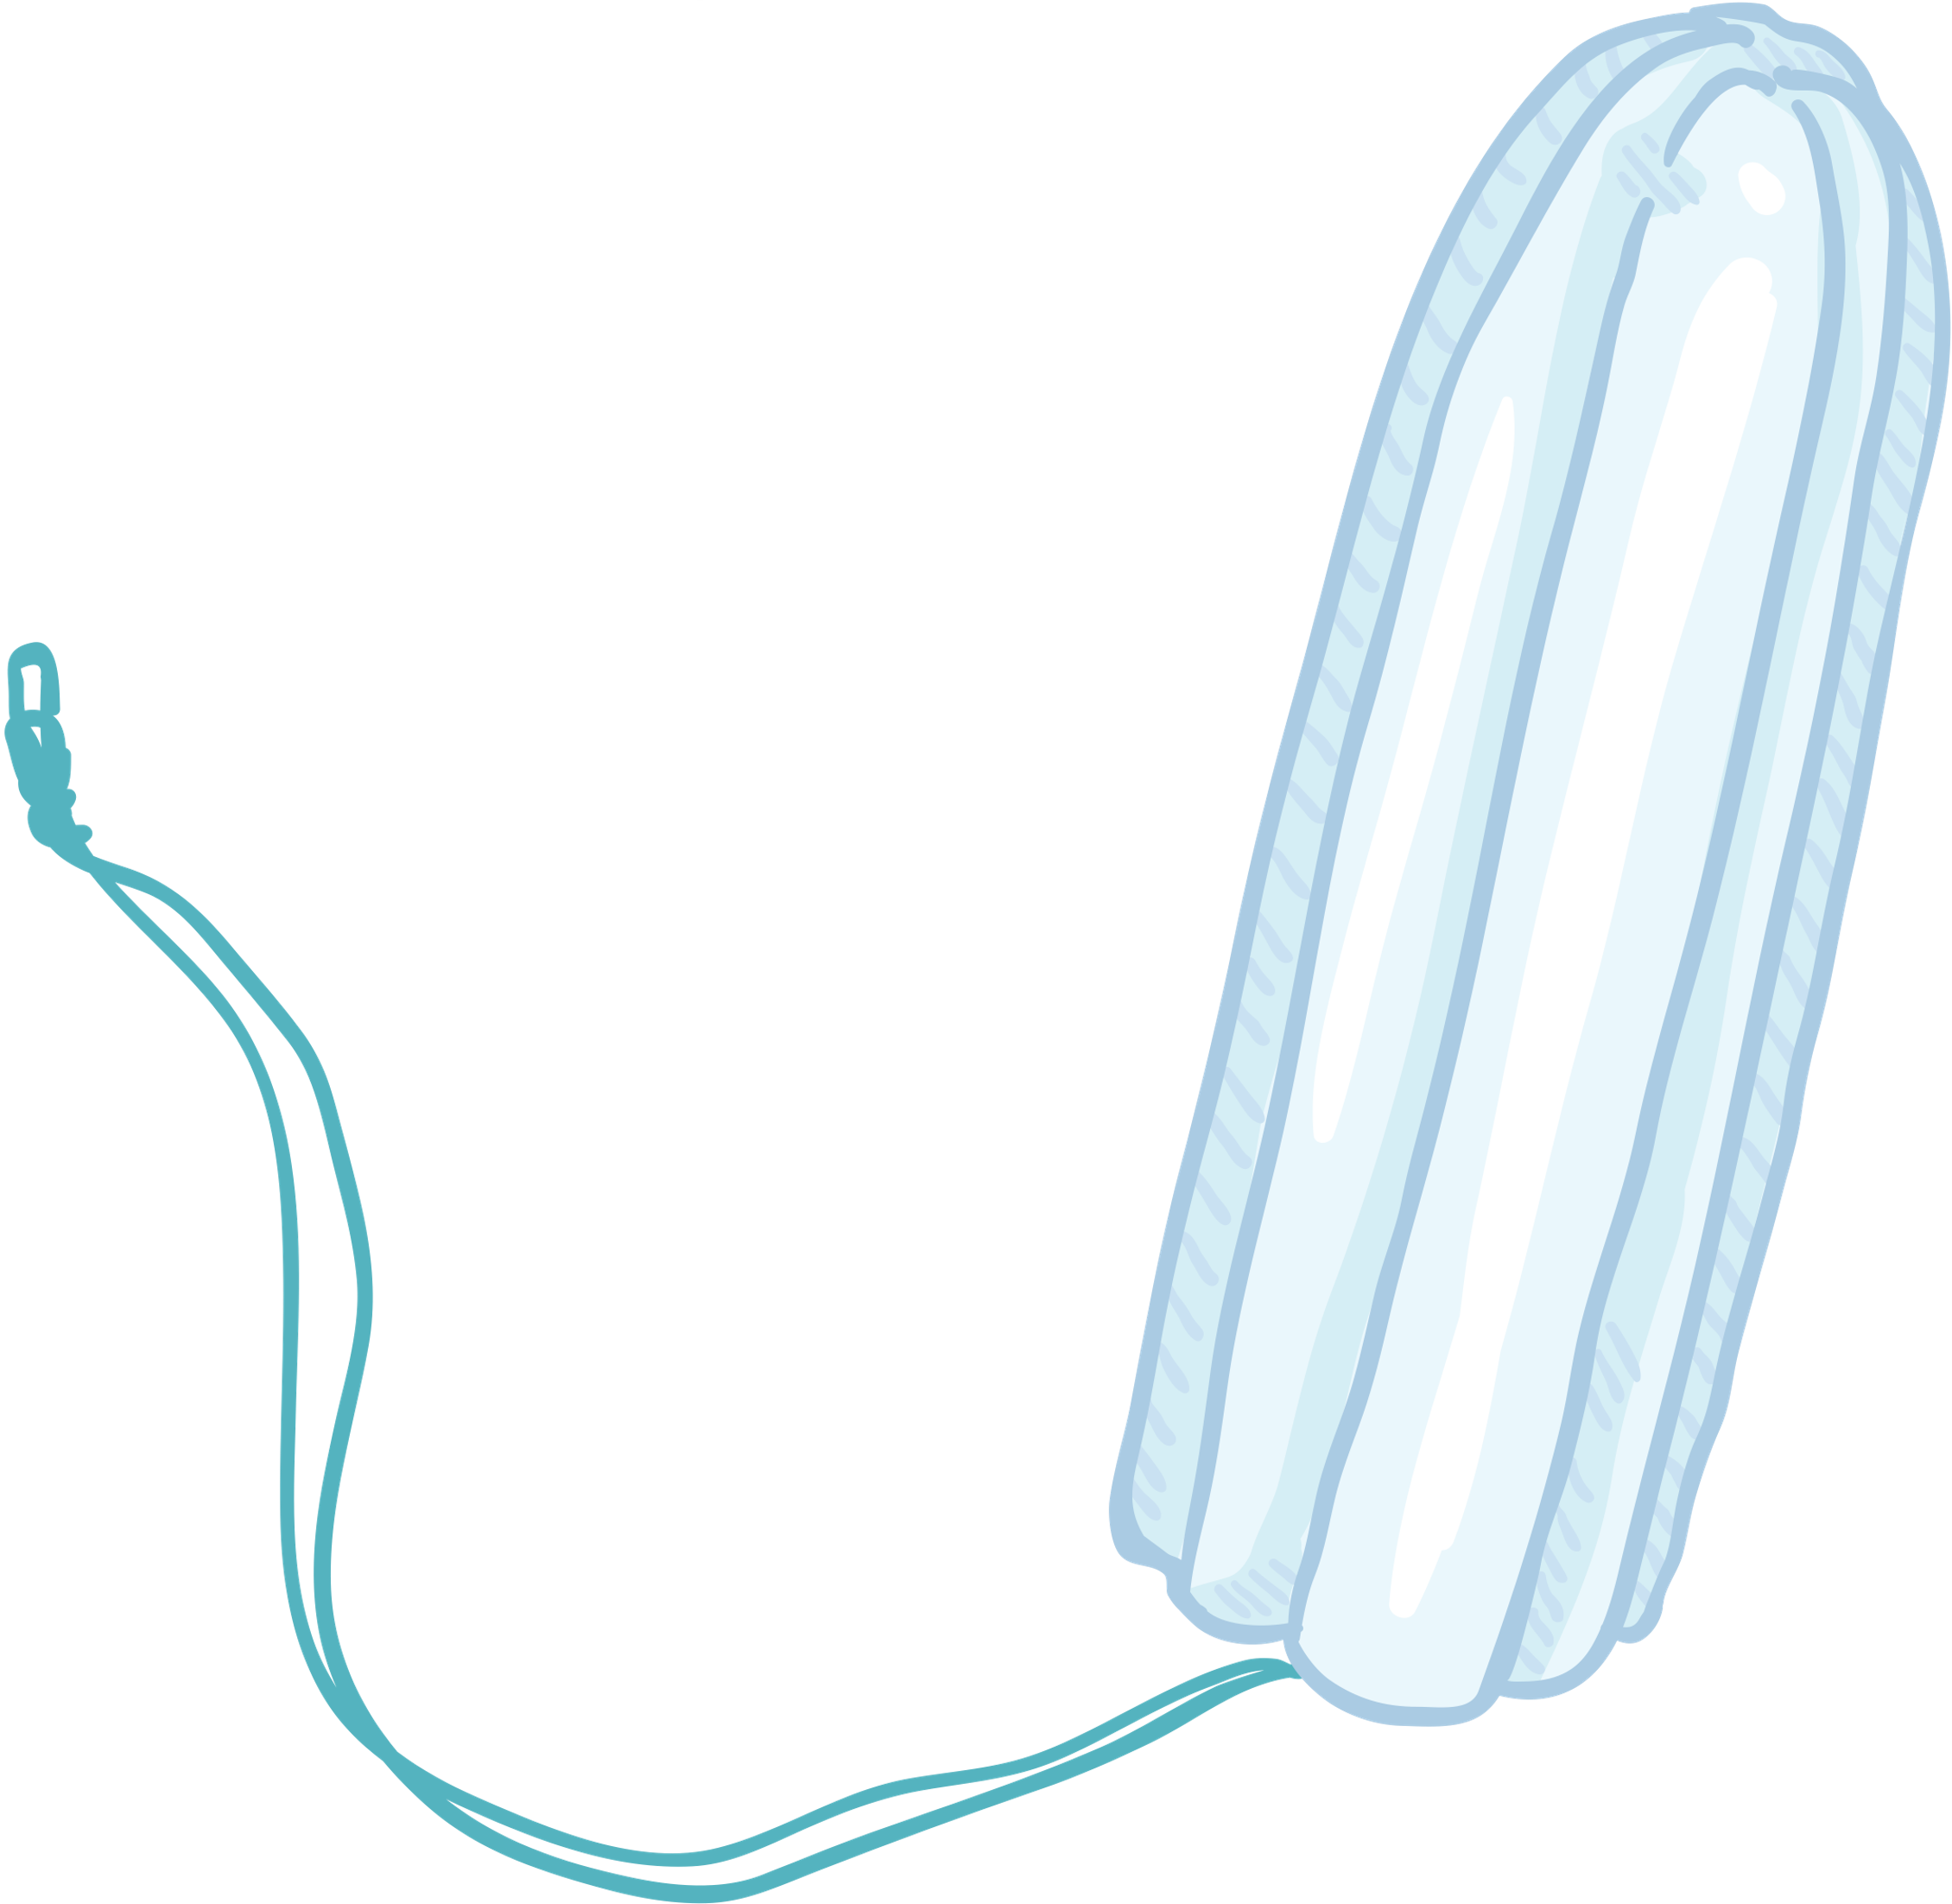


Take 10 activity 2
Physical changes at puberty / Ages 11-12 years/Slide 11
Notes:
Menstruation (period)
pad, tampon, menstrual cup, period pants

Slide 12
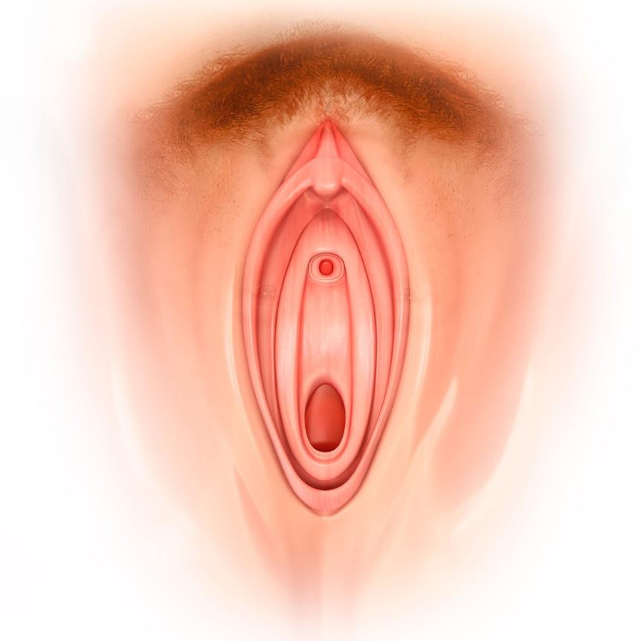
Take 10 activity 2
Clitoris
Urethral opening
(where urine/pee leaves the body)
Labia
Vaginal opening
Physical changes at puberty / Ages 11-12 years/Slide 12
Notes:
Correct terminology for female genitalia.

Slide 13



Take 10 activity 3
Puberty - True or False Quiz
  Face washing lots of times per day will reduce spots.
True False Not sure
FALSE: For both boys and girls it's important to stay clean and wash your face regularly, but too much washing can dry out the skin and cause irritation. Most spot breakouts are mild and can be treated with over-the-counter products, however, more severe acne needs to be treated by a doctor by prescribing medication.
Physical changes at puberty / Ages 11-12 years/Slide 13
Notes:
Take 10 Activity Choice 3:
Puberty true/false
This activity will test student knowledge about puberty. You may wish to use it as an assessment activity.
The quiz can be completed individually or in pairs. Give students a few moments to answer and then share the correct answers.

Slide 14
Take 20 activity 1
Puberty - True or False Quiz
2. Periods won't stop someone from swimming and doing other sports.
True False Not sure
TRUE: It's perfectly possible to carry on with sporting activities. Tampons can be used when swimming and it's very unlikely that any blood will leak out.
Physical changes at puberty / Ages 11-12 years/Slide 14

Slide 15
Take 20 activity 1
Puberty - True or False Quiz
3. Boys can experience unexpected erections during puberty
True False Not sure
TRUE: This can make boys feel self-conscious or embarrassed, however, as puberty progresses and hormones settle down unexpected erections become less frequent.
Physical changes at puberty / Ages 11-12 years/Slide 15

Slide 16
Take 20 activity 1
Puberty - True or False Quiz
4. Someone shouldn't have a bath when having a period.
True False Not sure
FALSE: Good personal hygiene is important and baths can also help with period cramps.
Physical changes at puberty / Ages 11-12 years/Slide 16

Slide 17
Take 20 activity 1
True or False Quiz
5. Breasts can have lumps in them during puberty.
True False Not sure
TRUE: Lumps can appear during puberty in both boys and girls, but these are almost always related to breast tissue development rather than illness. If you are ever worried speak to someone to get reassurance.
Physical changes at puberty / Ages 11-12 years/Slide 17

Slide 18
Take 20 activity 1
True or False Quiz
6. Puberty causes strong body odour
True False Not sure
FALSE: It is common for everyone to sweat more as they get older and go through puberty, however, good personal hygiene including washing/showering and using deodorant will avoid any strong body odour developing.
Physical changes at puberty / Ages 11-12 years/Slide 18

Slide 19
Take 20 activity 1
Puberty - True or False Quiz
7. Both breasts are always the same shape and size.
True False Not sure
FALSE: It is common for women have differently shaped breasts, one can be smaller or a slightly different shape than the other. It's totally natural.
Physical changes at puberty / Ages 11-12 years/Slide 19

Slide 20
Take 20 activity 1
Puberty - True or False Quiz
8. Everyone will know when a girl has their period.
True False Not sure
FALSE: Period products are very discreet and there it is unlikely that anyone could know if a girl or woman was menstruating.
Physical changes at puberty / Ages 11-12 years/Slide 20

Slide 21
Take 20 activity 1
Puberty - True or False Quiz
9. Periods are painful
True False Not sure
FALSE/TRUE/SOMETIMES: It's different for everyone, but most girls and women experience some mild discomfort. If periods are painful using a hot water bottle or taking some painkillers (with adult permission) should help. Periods can be more painful some months than others, like many other aspects of puberty this is unique to the individual.
Physical changes at puberty / Ages 11-12 years/Slide 21

Slide 22
Take 20 activity 1
Puberty - True or False Quiz
10. Boys always start puberty later than girls
True False Not sure
FALSE: In general girls start puberty a bit younger but it’s very much an individual experience. Some boys start puberty earlier than average and some girls start puberty a bit later than average. However, by the time boys and girls reach 18 almost all will have gone through puberty.
Physical changes at puberty / Ages 11-12 years/Slide 22

Slide 23

Take 20 activity 1
Physical changes at puberty / Ages 11-12 years/Slide 23
Notes:
Take 20 Activity Choice 1:
This activity focuses on the changes girls experience during puberty. Play the short video on slide 23 and then challenge students to complete the follow up tasks on slides 24-27.
Conclude the activity by going through slide 28.
VIMEO Link: https://vimeo.com/935334587/ff629cdb53?share=copy

Slide 24
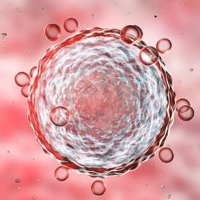
Take 10 activity 2
Menstruation or having a period
When a girl reaches puberty the o__ in her o_______ start to mature. This is because the hormone o_________ starts being ____. This usually happens sometime between ages 10 and 14 although it can happen earlier or later.
About once a ____ the hormone levels rise and one o___ is released from one of the ______. The o___ is about the size of a grain of ___ and can just about be seen with the naked e__. It moves through the f________ tube to the _____.
oestrogen
sand
ova
ovum
eye
month
uterus
ovaries
made
fallopian
Physical changes at puberty / Ages 11-12 years/Slide 24
Notes:
When a girl reaches puberty the OVA in her OVARIES start to mature. This is because the hormone OESTROGEN starts being MADE. Th
is usually happens sometime between ages 10 and 14 although it can happen earlier or later.
About once a MONTH the hormone levels rise and one OVA is released from one of the OVARIES The OVUM is about the size of a grain of SAND and can just about be seen with the naked EYE. It moves through the FALLOPIAN tube to the UTERUS.
NOTE: OVUM - singular
OVA - plural

Slide 25

Take 10 activity 2
Menstruation or having a period
The ____of the u____ becomes enriched with b_____. This prepares it for an ovum which will grow into a ____ if it has met a sperm through having sex. Most ova do not get __________, so they pass out of the body through the v_____ and v____ along with the l_____ of the u_____. This is called having a ______ or menstruation.
vulva
baby
blood
lining
period
fertilised
uterus
vagina
Physical changes at puberty / Ages 11-12 years/Slide 25
Notes:
The LINING of the UTERUS becomes enriched with BLOOD. This prepares it for a FERTILISED ovum which will grow into a BABY if it has met a sperm through having sex. Most ova do not get FERTILISED, so they pass out of the body through the VAGINA and VULVA together with the LINING of the UTERUS. This is called having a PERIOD or menstruation.

Slide 26
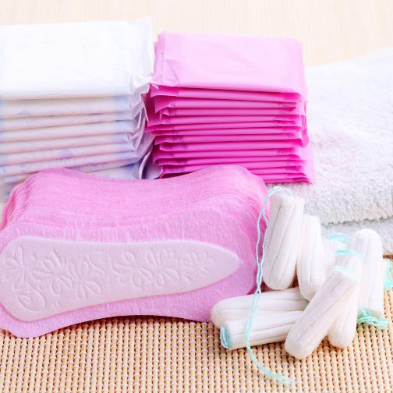
Take 10 activity 2
Menstruation or having a period
The amount of _____ passed is about 2-3 tablespoons or one eggcup full, but it varies. The same c_____ repeats every 21-35 days. At first periods may be ________ but they usually become more regular. Periods continue until around the age of 50 when periods stop, this is called the _________. A __ , _____ or combination of both are used during a period and should be changed regularly. Some girls and women prefer to use a _________ _______ as it’s more environmentally friendly and a fairly recent invention are _________ _________, which absorb blood without leaking and can be washed and re-used.
irregular
blood
pad
menstrual cup
menopause
cycle
tampon
period pants
Physical changes at puberty / Ages 11-12 years/Slide 26
Notes:
The amount of BLOOD passed is about 20-80ml or one eggcup full, but it varies. The same CYCLE repeats every 21-35 days. At first periods may be IRREGULAR but they usually become more regular. Periods continue until around the age of 50 when they stop, this is called the MENOPAUSE A PAD , TAMPON or combination of both are used during a period and should be changed regularly. Some girls and women prefer to use a MENSTRUAL CUP as it’s more environmentally friendly and a fairly recent invention are PERIOD PANTS which absorb blood without leaking and can be washed and re-used.

Slide 27
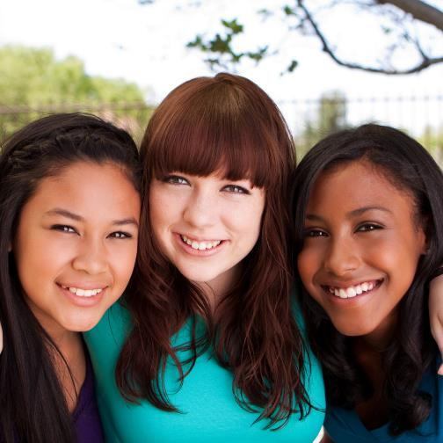
Menstruation or having a period
When having a period it's not unusual to feel _____ in the abdomen a few days before and during menstruation. A period can last between 3 and 8 ___. A ___ water bottle can help with period pain or you could take a painkiller such as _______. It can also be common to experience ___ swings, this is due to the oestrogen levels rising and falling. This is called ___ (premenstrual syndrome). This is also unique to every woman and not everyone experiences PMS.
PMS
safe
mood
days
ibuprofen
cramps
hot
vary
Physical changes at puberty / Ages 11-12 years/Slide 27
Notes:
When having a period it's not unusual to feel CRAMPS in the abdomen a few days before and during menstruation. A period can last between 3 and 8 DAYS. A HOT water bottle can help with period pains or you could take a painkiller such as IBUPROFEN. It can also be common to experience MOOD swings, this is due to the oestrogen levels rising and falling. This is called PMS (premenstrual syndrome). This is also unique to every woman and not everyone experiences PMS.
*NOTE: Explain the importance of medicine safety. Follow guidelines on the packet, Do not exceed the dosage and take medicine under adult supervision.

Slide 28

Advice about starting periods
  During a period it is usual for blood flow to slow down over a few days before stopping. A period shouldn’t stop you doing all the things you usually enjoy, and exercise can help with cramps.
  Periods are natural, but if anything is worrying you, speak to a trusted adult.
  Remember everyone's body is unique and your periods will be unique to you.
Physical changes at puberty / Ages 11-12 years/Slide 28
Notes:
Conclude the activity using the summary slide (28)

Slide 29
Take 20 activity 2
Male anatomy - can you label the diagrams correctly?
penis
epididymis
sperm
semen
testicles
scrotum
Physical changes at puberty / Ages 11-12 years/Slide 29
Notes:
Take 20 Activity 2:
This activity focuses on male reproductive anatomy and puberty.
Show slide 29 and ask students to make a note of the terms. Move through slides 30 to 35 and task students with matching each label to the area indicated on the slide.

Slide 30
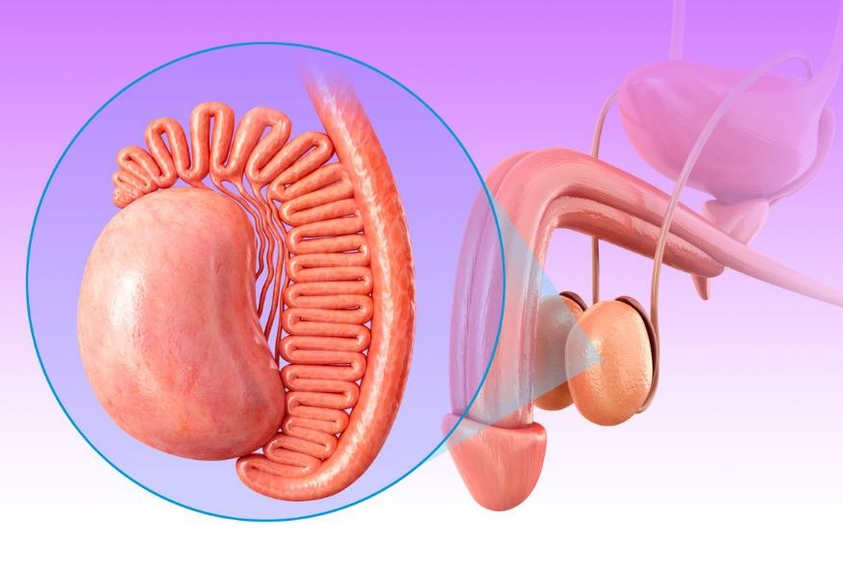
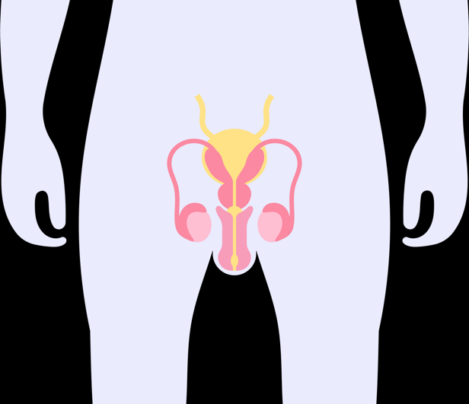
Take 20 activity 2
Physical changes at puberty / Ages 11-12 years/Slide 30
Notes:
Penis

Slide 31
Take 20 activity 2
Physical changes at puberty / Ages 11-12 years/Slide 31
Notes:
Testicle (s)

Slide 32
Take 20 activity 2
Physical changes at puberty / Ages 11-12 years/Slide 32
Notes:
Epididymis

Slide 33
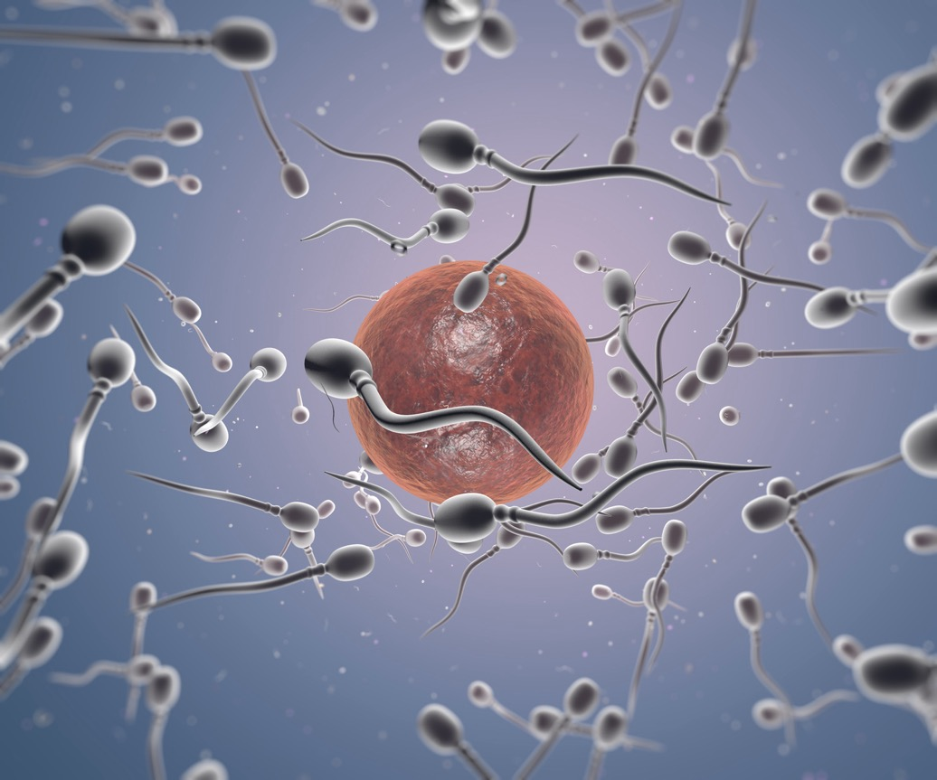
Take 20 activity 2
Physical changes at puberty / Ages 11-12 years/Slide 33
Notes:
Sperm

Slide 34
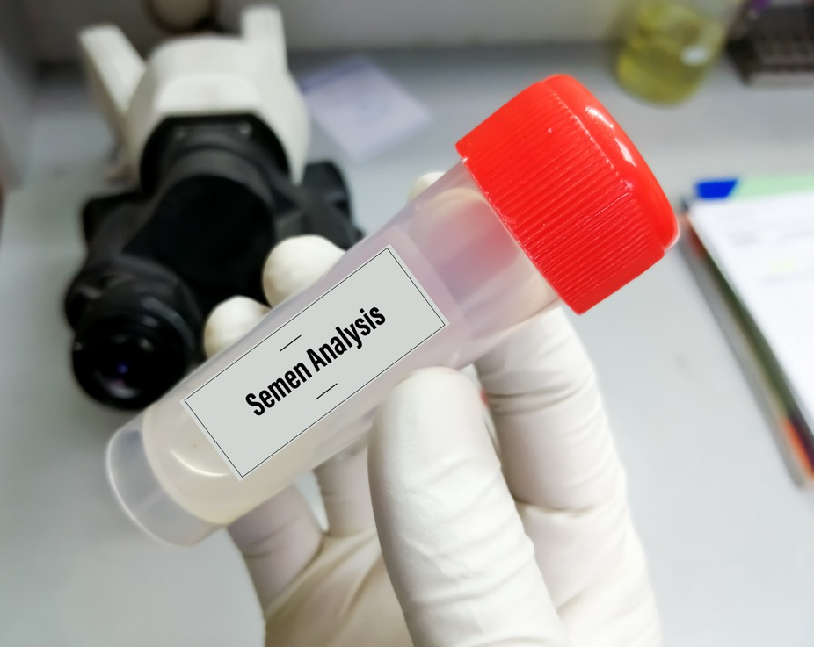
Take 20 activity 2
Physical changes at puberty / Ages 11-12 years/Slide 34
Notes:
Semen

Slide 35

Take 20 activity 2
Physical changes at puberty / Ages 11-12 years/Slide 35
Notes:
Scrotum

Slide 36

Take 20 activity 2
Physical changes at puberty / Ages 11-12 years/Slide 36
Notes:
Play the short video (just over 2 minutes) and then ask the students to complete slides 37 and 38.
Vimeon link: https://vimeo.com/935430314/6bb2cee99f?share=copy

Slide 37

Take 20 activity 2
Boys and puberty
Boys usually notice physical signs of puberty a little older than girls. This often begins with a g_____ s___. The t ______ get bigger and the p______ gets longer. H _______ grows under arms and boys may notice that they s_______ more. The voice will ______ and have a lower pitch. The main male hormone is t________.
Boys start to reach physical maturity from 15 years old and many will start to s________.
growth spurt
shave
break
hair
sweat
testosterone
penis
testicles
Physical changes at puberty / Ages 11-12 years/Slide 37
Notes:
Boys usually notice physical signs of puberty a little older than girls. This often begins with a GROWTH SPURT. The TESTICLES get bigger and the PENIS gets longer. HAIR grows under arms and boys may notice that they SWEAT more. The voice will BREAK and have a lower pitch. The main male hormone is TESTOSTERONE.
Boys start to reach physical maturity from 15 years old and many will start to SHAVE.

Slide 38
Take 20 activity 2
Boys and puberty
During puberty it is normal to have an unexpected e__________ . W____ d______
are common where boys e___________ s___________
when sleeping. These are all normal experiences of growing up.
By 18 most boys have completed puberty and reached full height, but m___________ continue to develop.
scrotum
muscles
semen
erection
wet dreams
ejaculate
Physical changes at puberty / Ages 11-12 years/Slide 38
Notes:
During puberty it is normal to have an unexpected ERECTION. WET DREAMS
are common where boys EJACULATE SEMEN
when sleeping. These are all normal experiences of growing up.
By 18 most boys have completed puberty and reached full height, but MUSCLES continue to develop.

Slide 39
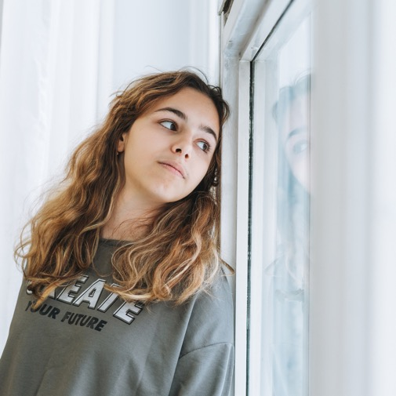
Take 30 Activity
Body changes in girls
    The first sign of puberty in girls can be breast development, but it's different for everyone. Puberty can start anywhere between 9 and 15 or even later.
    It's normal for breast buds (developing breast tissue) to be a little tender or for one breast to start to develop several months before the other one.
    There is no 'right time' for periods to start and it can take the body a while to get into a regular cycle.
    There will also be some outside changes to your vulva as this starts to mature. There is no particular way a woman's vulva looks. It's individual.
Physical changes at puberty / Ages 11-12 years/Slide 39
Notes:
Take 30 Activity
This activity brings together much of the previous information. If your group has already covered puberty at primary school, this could be used as a stand alone activity to recap and consolidate previous learning.
There are a number of ways to execute this activity. You might wish to print out the slides and pass around the class to read through in small groups (see printable materials at the end of the teacher notes). If any questions arise students can make a note of them and place in the question box.
Alternatively, you can take the class through the slides (39-47) asking them to make notes of anything they are unsure of, again to place in the question box.
To ascertain learning use the exercise on slide 48.

Slide 40

Take 30 Activity
Body changes in girls
    Girls may also get vaginal discharge- a white or clear fluid from the vagina. This isn't a period and is totally normal.
    Pubic hair is also likely to develop around the vulva. Over time it might become thicker.
    Hips widen and some girls naturally put on weight during puberty. It's important not to worry about body shape as everyone is unique.
    In general girls start and finish puberty earlier than boys and this can be from mid to late teens.
Physical changes at puberty / Ages 11-12 years/Slide 40

Slide 41
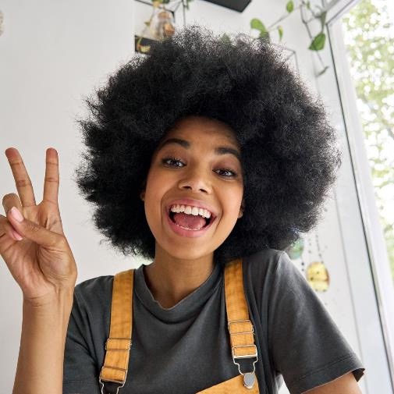
Take 30 Activity
Body changes in girls
    Surprisingly, facial hair can develop in everyone during puberty although for boys this is much more obvious.
    Most girls grow hair under their arms and start sweating more during and after puberty. Extra hair also grows on the arms and legs of some girls and again this is perfectly normal.
    Many girls and boys find that they get some spots and greasy hair during puberty. This is quite common and there are lots of gentle treatments for spots.
Physical changes at puberty / Ages 11-12 years/Slide 41

Slide 42
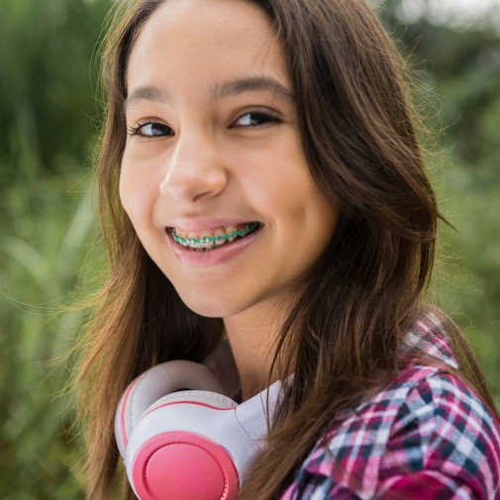
Take 30 Activity
Body changes in girls
    Just like boys, girls will also experience a growth spurt.
    Puberty tends to start at an earlier age in girls so they may be taller initially but most boys will catch up with many continuing to grow taller than girls in general.
    Masturbation is where someone explores and touches their private parts for pleasure. It's a perfectly natural and private thing for both boys and girls to do.
Physical changes at puberty / Ages 11-12 years/Slide 42

Slide 43

Take 30 Activity
Advice about starting periods
    Don't worry if the blood changes colour during a period. This is quite natural.
    At first periods can be irregular so be prepared and have period products in your school bag or locker, or know where you can get them in school.
    A change of underwear is also useful to have in school.
Physical changes at puberty / Ages 11-12 years/Slide 43

Slide 44

Take 30 Activity
Body changes in boys
The first sign of puberty is usually the testicles starting to develop. The skin on the scrotum starts to get thinner and may appear darker or redder. Pubic hair starts to develop around base of the penis.
The chest and shoulders become broader and the body becomes generally more muscular. There can be temporary swelling in the chest but this is not uncommon and usually disappears after a year or two.
Physical changes at puberty / Ages 11-12 years/Slide 44

Slide 45

Take 30 Activity
Body changes in boys
Erections can happen unexpectedly and this is a normal occurrence in puberty.
Wet dreams may happen - this is nothing to be embarrassed about. Boys also develop a deeper voice - as their voice 'breaks'.
It’s common for boys to develop acne, but there are lots of treatments available and for most it settles down or clears up within a few years.
Physical changes at puberty / Ages 11-12 years/Slide 45

Slide 46

Take 30 Activity
Body changes in both
Surprisingly, facial hair can develop in everyone, although in males it is much thicker, darker and covers more of the face. However, some girls also notice an increase in facial hair during puberty.
Most people grow hair under their arms and genitals and start sweating more during and after puberty. Extra hair also grows on the arms and legs of most people. This tends to be thicker and darker in males.
Shaving is an option for anyone to get rid of excess hair.
Spots and greasy hair is common, but doesn't happen to everyone.
Physical changes at puberty / Ages 11-12 years/Slide 46

Slide 47

Take 30 Activity
Body changes in both
The development of breasts and genitals occurs at a different rate amongst individuals, however, by the age of 16-17 almost everyone will have gone through puberty.
Most will also experience a growth spurt, but this often depends on your genetics. Puberty tends to start earlier in girls.
Masturbation is where someone explores and touches their genitals for pleasure. It's a perfectly natural and private thing to do. There is no ‘normal’ amount of masturbation - some people do it more, and others less.
Physical changes at puberty / Ages 11-12 years/Slide 47

Slide 48
Take 30 Activity
Body changes: sort the cards into these 4 categories.
Use the 'we're not sure' category for anything you need your teacher's help with.
Changes happen in
girls
Changes happen
in boys
Changes happen
in both
We're not
sure
Physical changes at puberty / Ages 11-12 years/Slide 48
Notes:
This activity can be completed individually or in small groups and used to check learning as well as any misperceptions.
Students should make 4 headings in a note book, paper, mini whiteboard. Move onto slide 49 and task the group with placing each statement under the correct heading. Continue the exercise using slide 50.
Printable version is available at the end of the teacher notes. If you wanted a more tactile exercise, cut out the statements and place under headings.
As students complete the task check for any misunderstandings and give feedback as required.

Slide 49
Take 30 Activity
Greasy
skin
Hair under arms
Grow taller
Vaginal discharge
Hair around
penis &
testicles
Erections
Genitals
mature
Masturbation
Chest & shoulders broaden
More hair on arms and legs
Hips widen
Wet dreams
Physical changes at puberty / Ages 11-12 years/Slide 49

Slide 50
Take 30 Activity
Breasts develop
Grow hair around vulva
Menstruation
Grow hair around vulva
More muscular
Facial hair
Greasy hair
Sweat more
Voice breaks
Start shaving
More muscular
Spots
Physical changes at puberty / Ages 11-12 years/Slide 50

Slide 51

Challenge activity -
Puberty survival guide
Using what you have learnt about puberty, create a single sided 'survival guide' for someone your age about what you think are the key things to know about puberty.
Aim to make it engaging, provide correct information and try to be reassuring.
Physical changes at puberty / Ages 11-12 years/Slide 51
Notes:
This is a less structured activity and could also be used to assess understanding about puberty.

Slide 52

It's a wrap!
  Puberty is a natural part of growing up and although similar things happen, everyone has an individual experience.
  Getting support from friends can be helpful but remember their puberty may differ from yours.
  If you're worried about anything it's helpful to speak to a trusted adult. This might be someone, at home e.g., your parents or school.
  Puberty is an exciting time as it's one of your major steps to becoming an adult. Try to see it as a positive experience rather than worrying about all the changes that are happening to your body.
Physical changes at puberty / Ages 11-12 years/Slide 52

Slide 53

Help and advice
If you need further advice or guidance about puberty a good place to start is a trusted adult in school such as a teacher, a school counsellor, health nurse or guidance teacher. These webpages are also helpful:
https://www.childline.org.uk/info-advice/you-your-body/puberty/puberty-girls/
https://www.childline.org.uk/info-advice/you-your-body/puberty/puberty-boys/
Physical changes at puberty / Ages 11-12 years/Slide 53

Slide 54

Assessment, progress, homework
Write down 3 new things you learned in this session.
What would you say to a younger friend who was worried about puberty? Give 2 examples of how you could reassure them.
Can you give an example of how what you’ve learned about puberty links to other lessons you’ve had in school?
Physical changes at puberty / Ages 11-12 years/Slide 53

