Slide 1
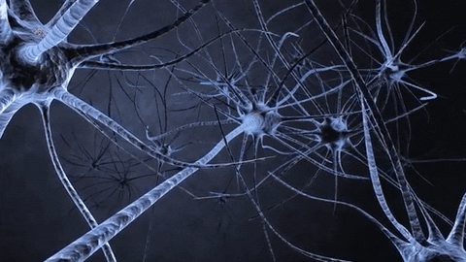

Slide 2
Welcome
Year 11 Revision Evening

Slide 3
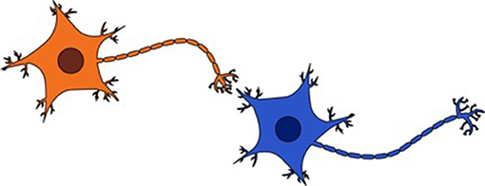
How Our Brain Works
Your brain is primarily composed of about 85 billion neurons, which is more than the number of stars you can see with the naked eye in the night sky. A neuron is a cell which acts as a messenger, sending information in the form of nerve impulses (like electrical signals) to other neurons

Slide 4
When you stop practicing something, the connections between your neurons weaken and can ultimately be dismantled or pruned.

Slide 5
Use it or lose it

Slide 6
But don’t worry - you can strengthen your neurons
The fact that learning rewires your neurons shows how dynamic (plastic) your brain is—that the brain changes and does not remain fixed. Practicing or rehearsing repeatedly activates your neurons and makes you learn.

Slide 7
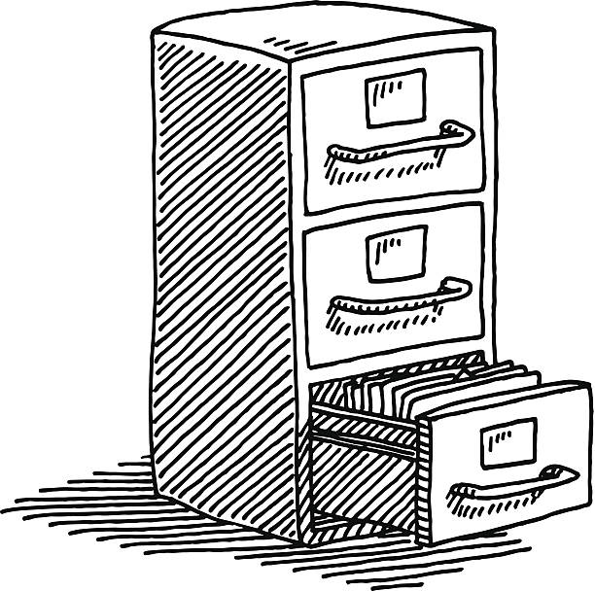
This includes how often you revisit the subject matter as it take time to go into your long term memory

Slide 8
Activate your neurons often!
When you do try to recall what you have learned and make a mistake, it can help you identify gaps in your learning and give you an indication of which trail still needs to be worked on.
Use:
Quizzes
Flashcards
Mind-maps
Presentations

Slide 9
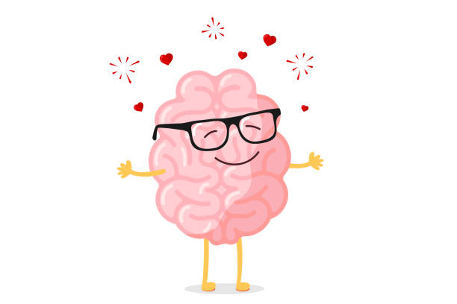
Planning is key
By having a plan it might reduce your stress.
But it needs to be achievable, so it doesn’t cause more stress.
Remember to stop cognitive overload ‘revise in small chunks’ 20 minutes then a break. (Unless you are doing a practice paper)

Slide 10
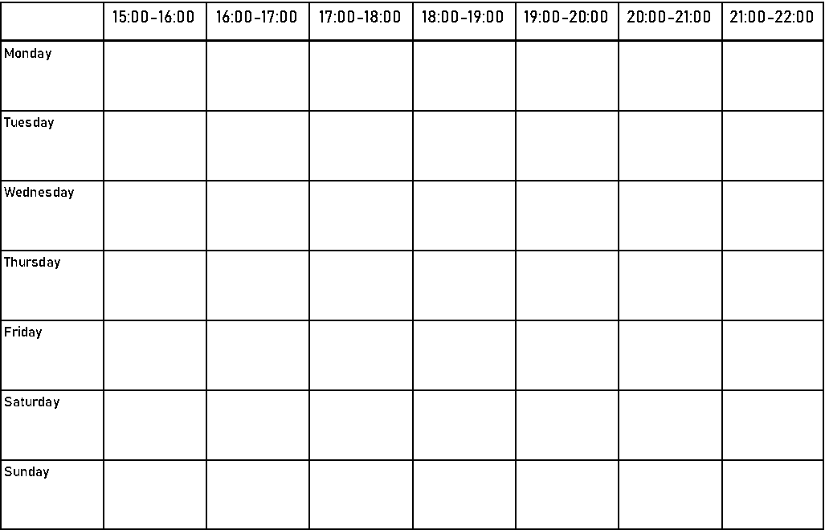
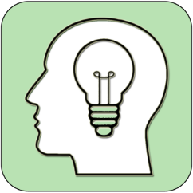
A revision Timetable can reduce stress
What do you think are the benefits of having a revision timetable?
Notes:
Discuss the shocking statistics

Slide 11
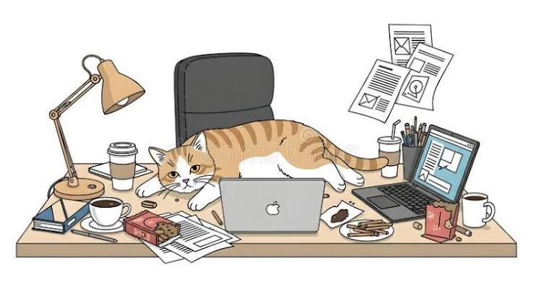
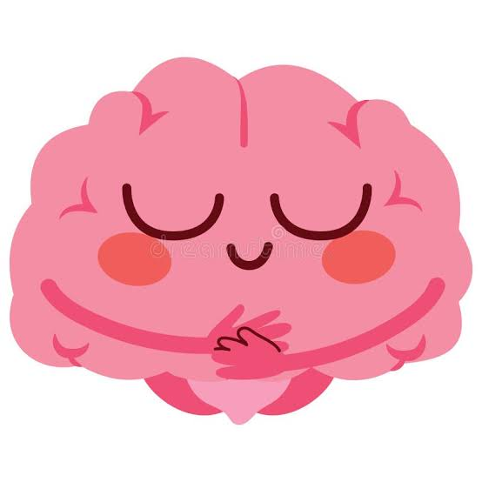

Study Spaces

Slide 12



Devices

Slide 13
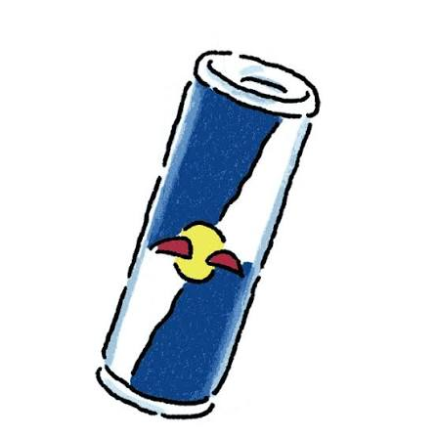
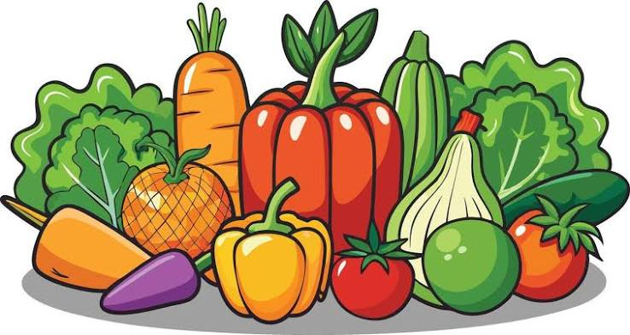
Food

Slide 14
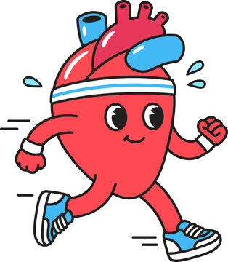
Exercise

Slide 15
Do Other Stuff
Grows brain cells: Interacting with others engages all your senses, which strengthens connections between brain cells and encourages neuroplasticity.
Strengthens Neural Pathways
Fights stress hormones: Positive contact lowers cortisol, a chemical that harms memory centers in the brain over time.
Releases feel-good chemicals: Activities and social time release dopamine, oxytocin, and serotonin. These improve your mood and protect your mental health

Slide 16
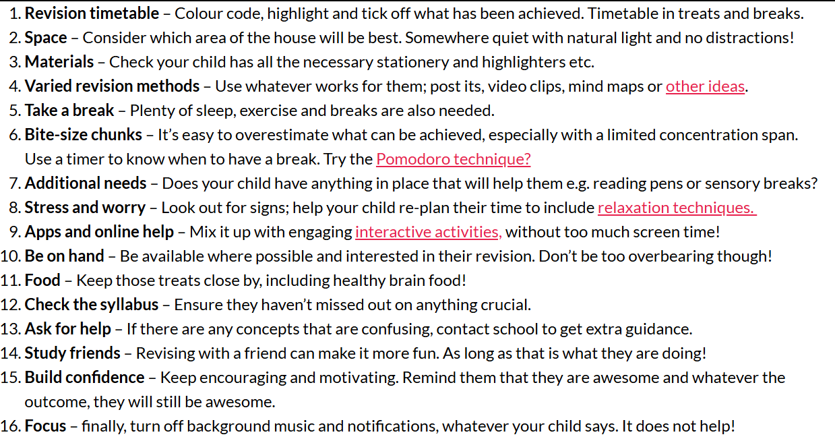

Slide 17

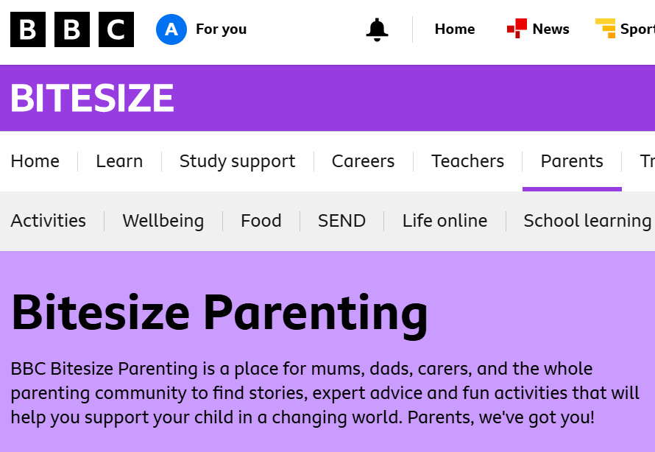
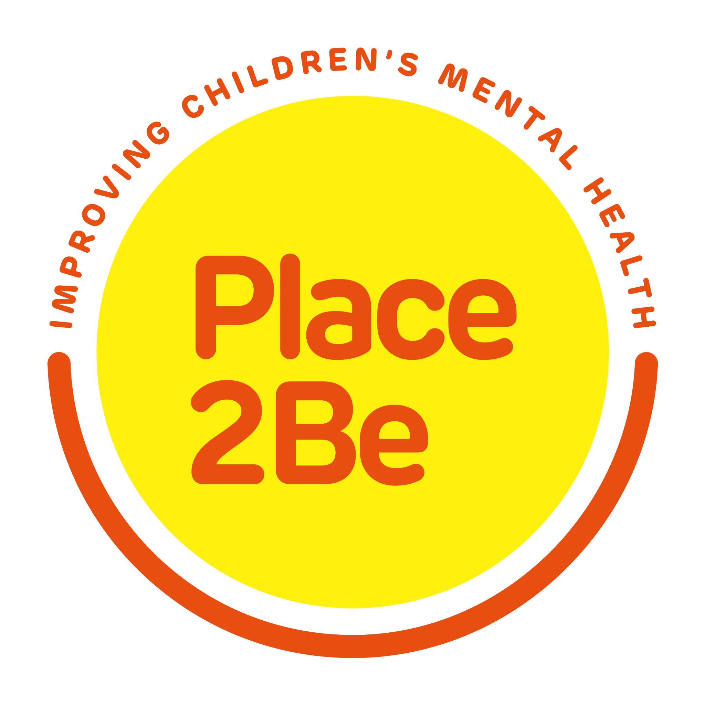
Useful Links
https://www.place2be.org.uk/media/pnxjiuwl/navigating-exam-season-guide-for-parents.pdf

